Slide 1
Vectorization and Apply
Lecture 9

Slide 2
Review: Loops
Programming languages are powerful because they allow you to automate repetitive tasks
Previously, we saw how loops are one way to automate these tasks
For
While
R actually handles loops somewhat poorly

Slide 3
Review: Loops
R is an interpreted, high-level language
R on the backend
i <- 1
i <- “hello”
Names <- c(“Jeff”, “Simeon”, “Shifra”)
Looping in the backend

Slide 4
Review: Loops
Problems
Computing time
Readability
Debugging

Slide 5
Vectorization
The base unit in R is ____________
What this means for R’s backend

Slide 6
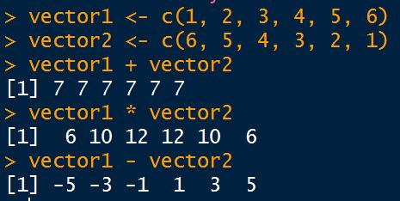
Vectorization
You’ve already been doing this

Slide 7
Apply
Vectors are the best, loops are a problem, so?
Apply family provides a solution
Can perform non-vectorized functions over vectors, matricies, or data frames
Aggregation
Transformations, including subsetting
Functions that return complex objects
Vectors
Matricies
Data Frames

Slide 8
Apply
Same components as a loop:
A collection of data
A function to apply over that data, row-by-row, or column-by-column

Slide 9
Apply
Why is it better?
Readability
Computational Time
Hirability
Seeking help online
Aesthetic value

Slide 10
Apply
Recall, in R, what is a:
Vector
List
Matrix
Data frame
Subsetting using [ notation

Slide 11
Apply
apply(X, MARGIN, FUN, …)
X an array, including a matrix
A vector denoting whether to run the function over the rows or columns of the input
1 = rows (default)
2 = columns
c(1, 2) = rows and columns
the function to be applied
You’ll need to quote functions like +, -, %*%, etc
… other arguments to feed into the function
na.rm = TRUE, etc etc

Slide 12
lapply
Returns a list of the same length as X, each element of which is the result of applying FUN to the corresponding element of X.

Slide 13
sapply
sapply is a user-friendly version of lapply by default returning a vector or matrix if appropriate.

Slide 14
vapply
vapply is similar to sapply, but has a pre-specified type of return value, so it can be safer (and sometimes faster) to use.

Slide 15
mapply
mapply is a multivariate version of sapply. mapply applies FUN to the first elements of each (…) argument, the second elements, the third elements, and so on.

Slide 16
replicate
vectorized rep()!

Slide 17
When to use a loop
Some functions don’t take in vector arguments
Output of lm()
You can sometimes work around this with other packages
Loops where each iteration is dependent on the output of the previous iteration
Cumulative functions
Random walks
There are still some vectorized solutions available

